Slide 1


Free Software
Microsoft Imagine and VMware

Slide 2
Sign into your Email
Step 1: Head over to your TCC email address and Sign in.
Step 2: At the begin of the semester you should see these emails in your inbox, or something similar:
Step 3: Click on both of the emails.
Step 4: Go to the next few slides for more information.

Slide 3
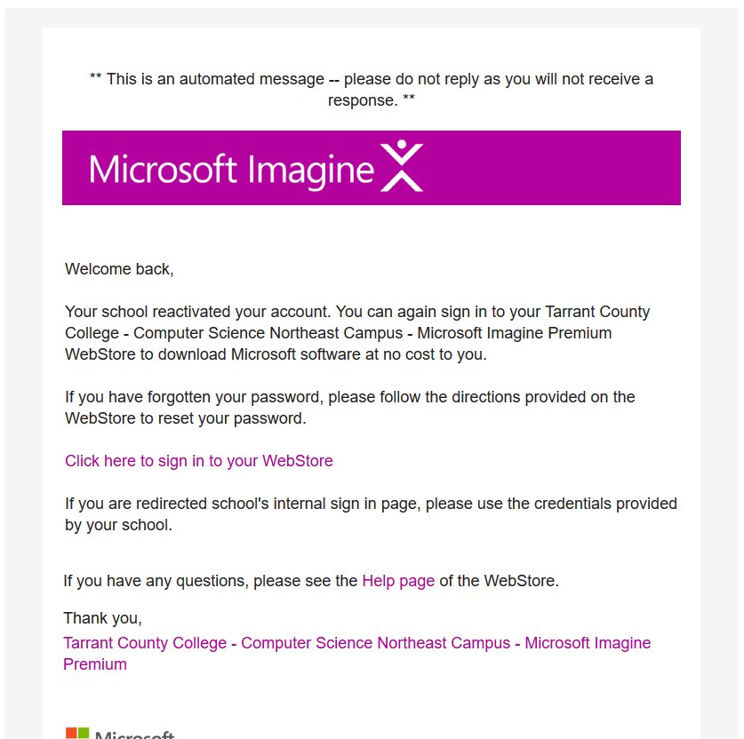
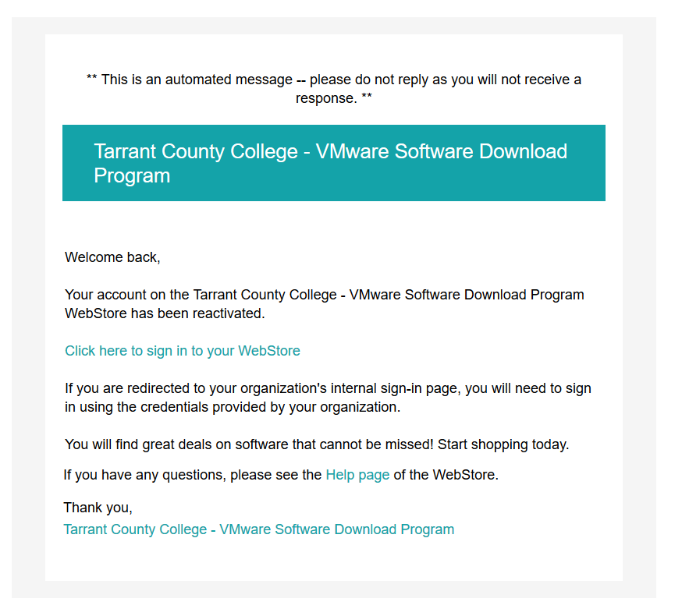
Follow either one of these links in your email to either register for the first time or re-register your account for this semester.

Slide 4
Here are links to VMware and Microsoft Imagine:
VMware:
https://e5.onthehub.com/WebStore/ProductsByMajorVersionList.aspx?cmi_cs=1&cmi_mnuMain=16a020b5-ed3c-df11-b4ab-0030487d8897&ws=d80efa53-723a-de11-b696-0030485a8df0&vsro=8
Microsoft Imagine:
https://e5.onthehub.com/WebStore/ProductsByMajorVersionList.aspx?cmi_cs=1&cmi_mnuMain=bdba23cf-e05e-e011-971f-0030487d8897&ws=818d8feb-c79b-e011-969d-0030487d8897&vsro=8

Slide 5
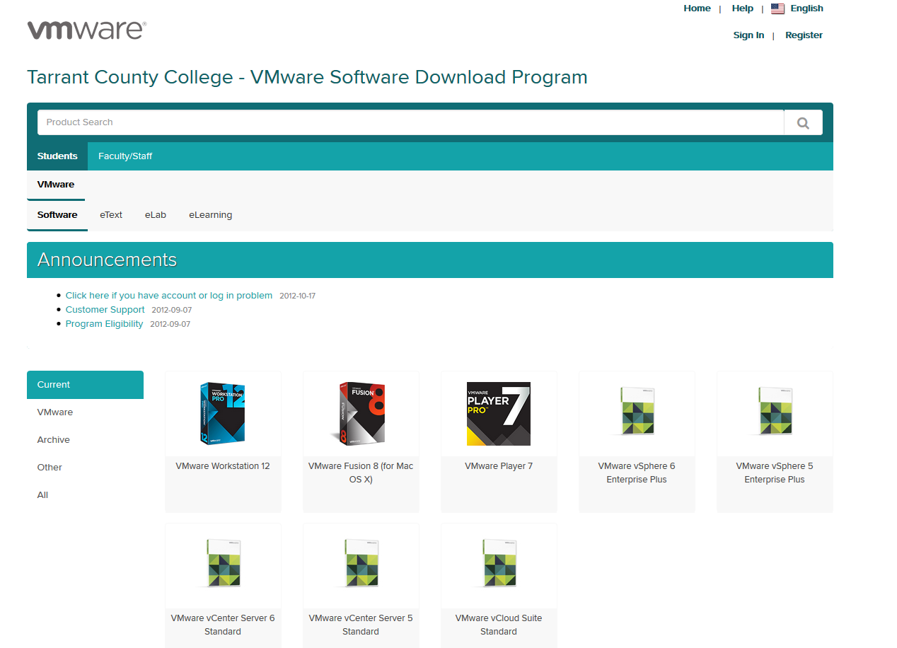
If you need VMware grab free a copy of VMware Workstation.

Slide 6
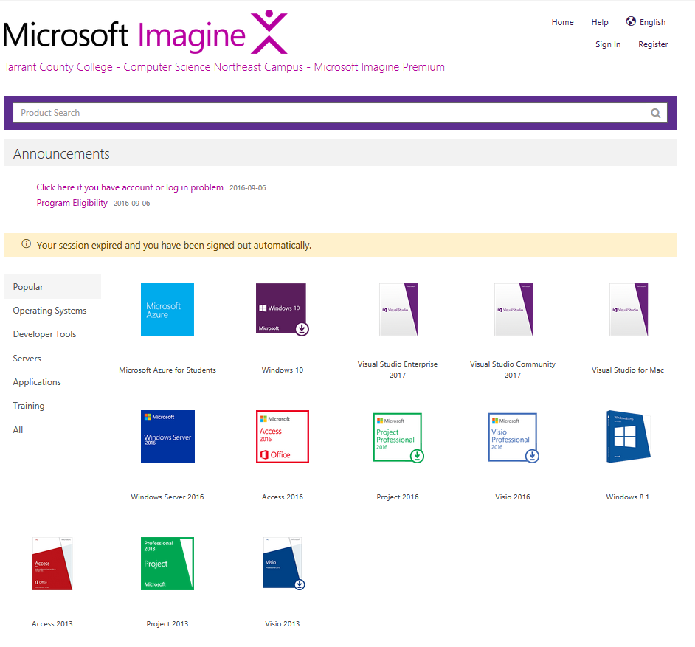
This is the current required version of Visual Studio for COSC 1436 Programming Fundamentals.
You can also grab free copies of Windows operating systems, Microsoft Visio, and etc.

